Slide 1
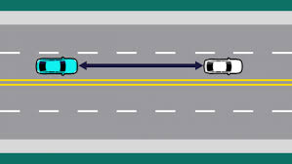

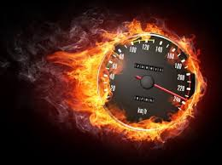
TIME, DISTANCE AND SPEED
IMP FORMULAE
TEAM 4[AL]

Slide 2
IMPORTANT FORMULAE :
S=SPEED D=DISTANCE T=TIME
1. SPEED(S)=DISTANCE(D) / TIME(T)
2. DISTANCE IS CONSTANT:
SPEED INVERSILY PROPORTIONAL TO TIME.
s1 t1 = s2 t2
s1 t1 = s2 t2

Slide 3
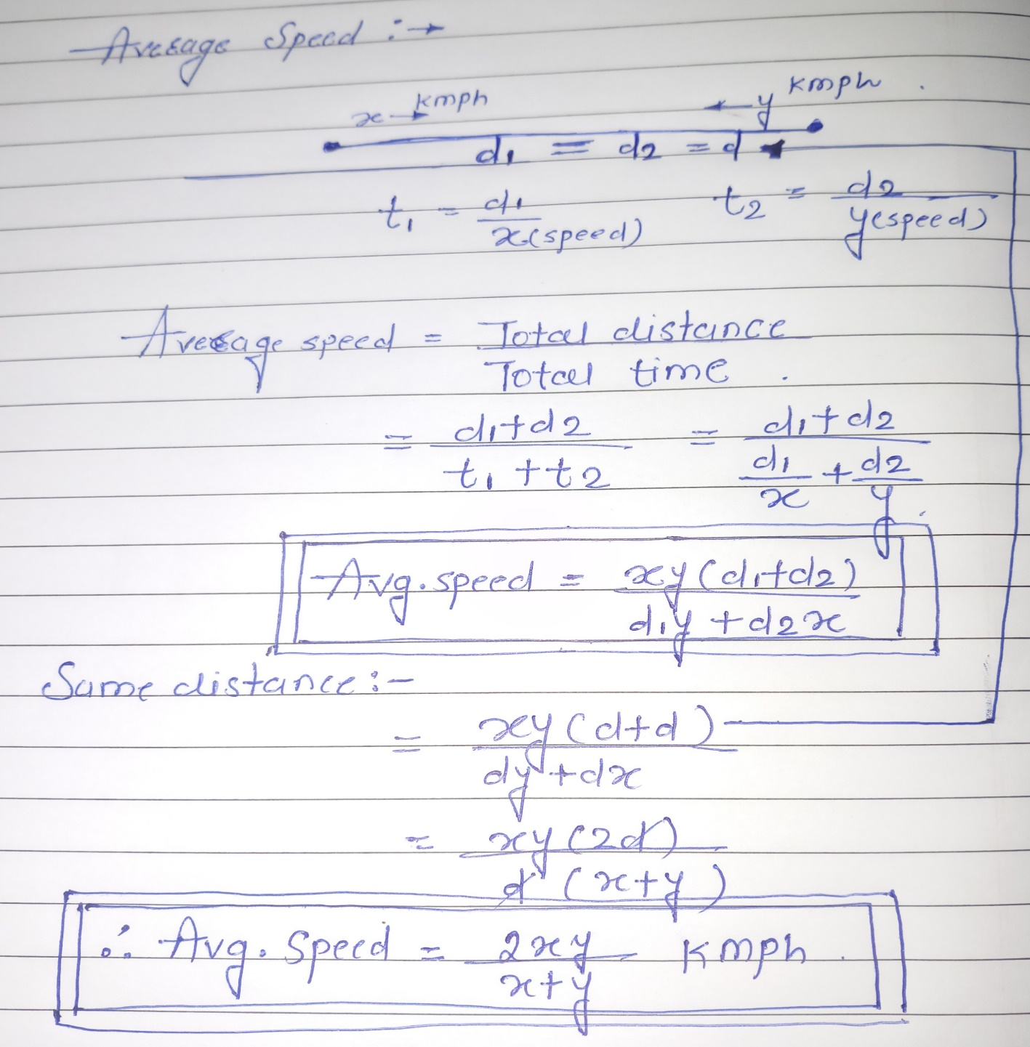
AVERAGE SPEED:

Slide 4
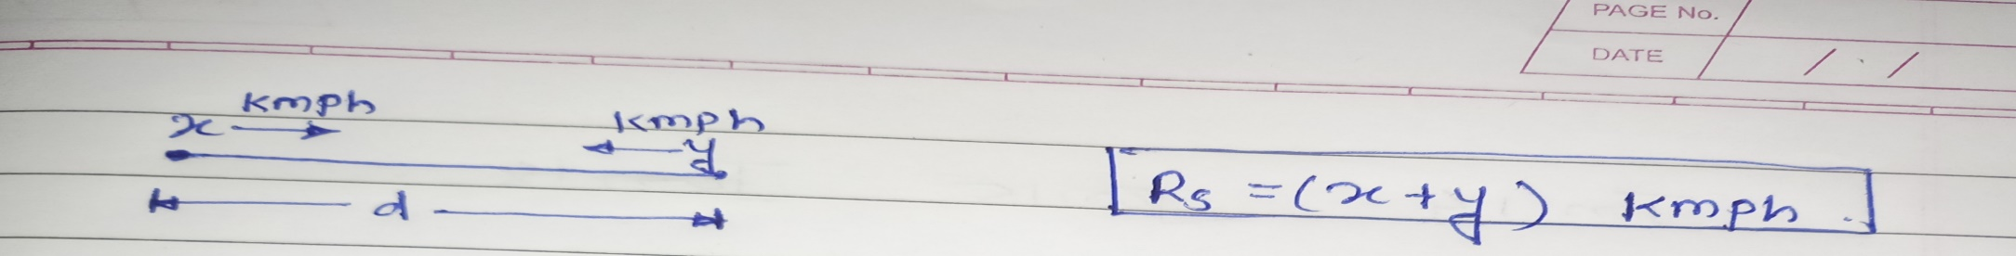
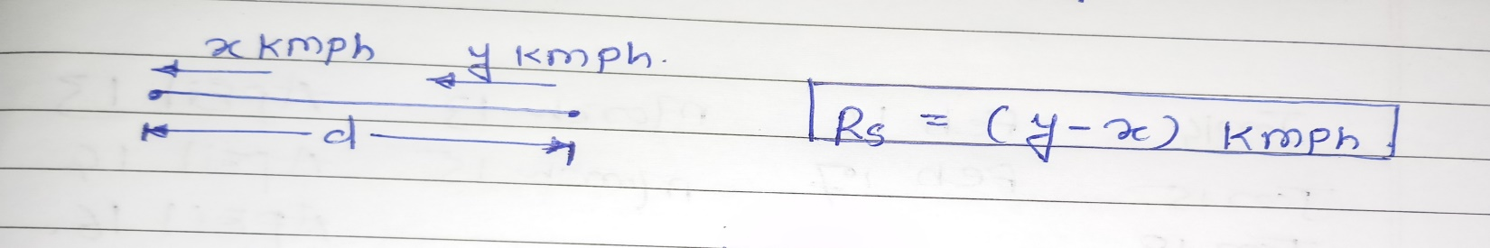
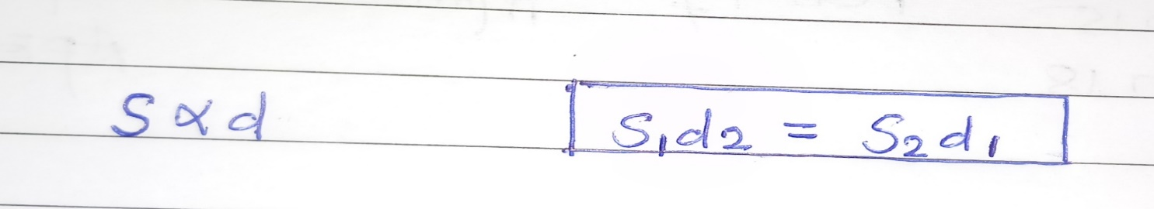
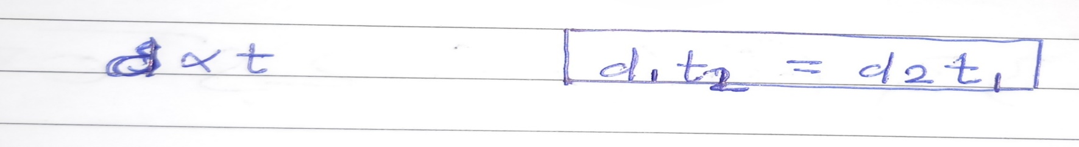
RELATIVE SPEED:
1.In opposite direction:
2.In same direction:
3.Time is constant:
4.Speed is constant:

Slide 5
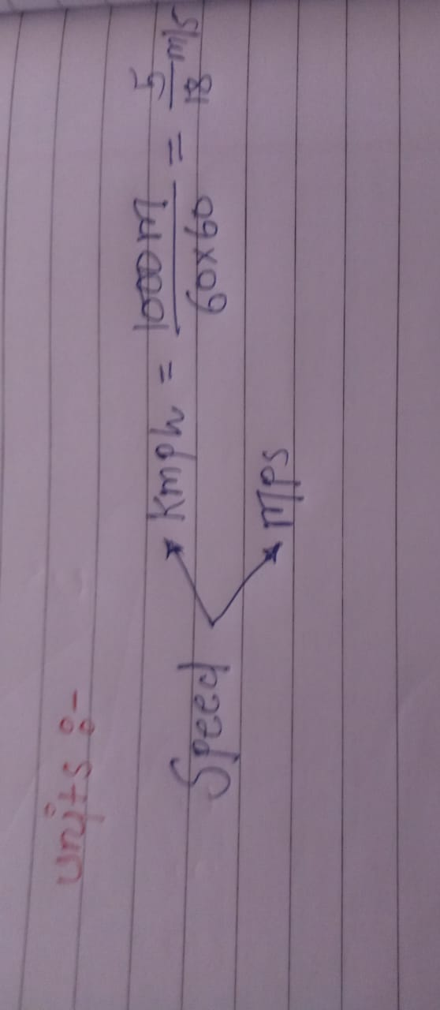
UNITS :--

Slide 6
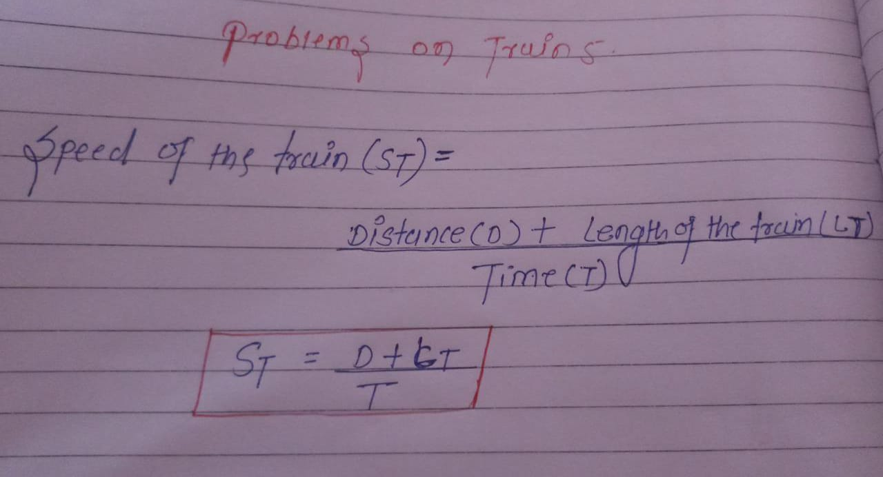
PROBLEBMS ON TRAIN:--

